Slide 1
Smart Neighbourhood Simulator
Live your life
We will take care of the rest
Group name: Group #1
Prof. Shahar Maoz Workshop
School of Computer Science
Tel Aviv University, Israel

Slide 2

Main components of the system
Server
Written in Java.
Controls connection with both Spectra and client side.
Client
Written in JS.
User interactive.
Controller
Written in Spectra.
Controls system’s logic in response to environment’s desires.

Slide 3
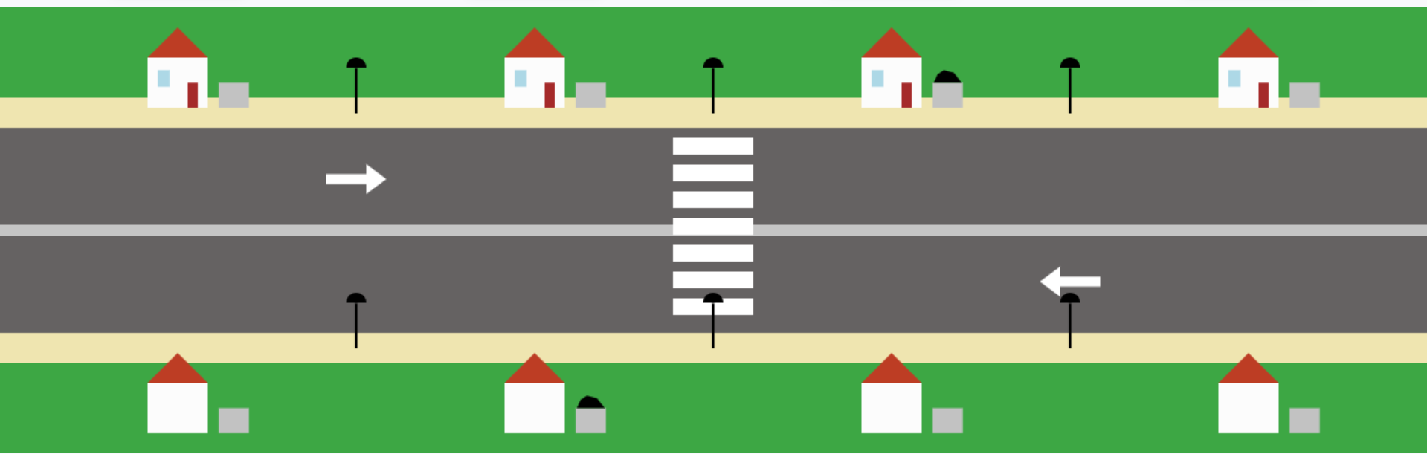

Spectra Environment Entities
Environment controlled entities
N Garbage Cans on each side of rode:
GarbageCansNorth boolean array.
GarbageCansSouth boolean array.
Pedestrian location Sensor - Pedestrians boolean array.
DayTime enum {DAY, NIGHT}.
EnergyEfficiencyMode boolean.

Slide 4
Spectra – Main Assumptions
Initial Assumptions:
asm side_walk_starts_empty:
forall i in Int(0..(PEDEST_WALK_SIZE-1)). pedestrians[i] = false;
asm all_cans_start_empty:
forall i in Int(0..(N-1)). ((!garbageCansNorth[i]) & !garbageCansSouth[i]);
asm dayTime = DAY;
Trucks won’t get stuck forever in front of The Crosswalk: Crosswalk will eventually be free of pedestrians.
Eventually always it will become NIGHT, and it will become DAY.

Slide 5
Spectra – Main Assumptions
Garbage Can Logic:
Eventually always, all garbage cans will become full.
If a garbage truck is in front of a full garbage can and it is in cleaning mode, then on the next step, the can will be empty.
asm G forall i in Int(0..(N-1)). ((garbageTruckNorth_location = i) & garbageCansNorth[i] & isCleaningN) -> next(!garbageCansNorth[i]);
Each full garbage can will stay full, until it is cleaned by a garbage truck.
asm G (garbageCansNorth[0] & (garbageTruckNorth_location != 0 | !isCleaningN)) -> next(garbageCansNorth[0]);

Slide 6
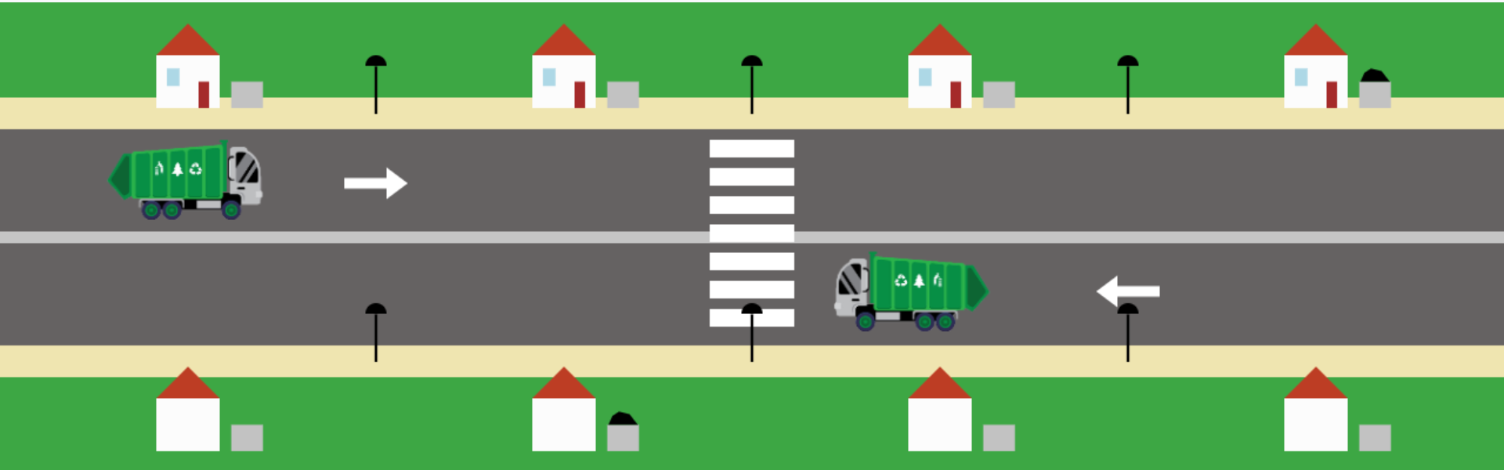
Spectra System Entities
System controlled entities
Control of each truck’s location and cleaning mode:
GarbageTruckNorthLocation int.
IsCleaningN boolean.
GarbageTruckSouthLocation int.
IsCleaningS boolean.
Lights boolean array.

Slide 7
Spectra – Main Guarantees
Initial Guarantees: Trucks start out not cleaning & at parking.
Garbage Truck Logic:
Trucks won’t run over pedestrians on the crosswalk.
Eventually always, the truck will come clean all full cans.
predicate isCleaningGarbageNorth(Int(0..(3)) i):
(garbageCansNorth[i] & (garbageTruckNorth_location = i) & isCleaningN);
If a truck is in front of a full can, it will clean it next turn.
Garbage trucks on the street, can only move one step forward, or stay in place.
Garbage trucks that are not in the street, can only appear at the start of the road.

Slide 8
Spectra – Main Guarantees
North Garbage Truck Movement Logic:
We used weights to induce the north truck to go clean, when cans are full:
define at_least_one_can_full_north :=
garbageCansNorth[0] | garbageCansNorth[1] | garbageCansNorth[2] | garbageCansNorth[3];
weight -1
at_least_one_can_full_north & garbageTruckNorth_location = N;
weight 1
!(garbageTruckNorth_location = N) & at_least_one_can_full_north;

Slide 9
Spectra – Main Guarantees
South Garbage Truck Movement Logic:
We used triggers and G to enforce the south truck to wait at parking if no can is full, and to leave if at least one is full.
gar G (all_cans_empty_south & (garbageTruckSouth_location = N)) -> (next(garbageTruckSouth_location) = N);
gar trig [true]*[at_least_one_can_full_south & (garbageTruckSouth_location = N)] |=> [garbageTruckSouth_location = 0]+;

Slide 10
Spectra – Main Guarantees
Light Logic:
During the day, all lights are always off.
During the night:
If Energy Efficiency Mode (EEM) is off, all lights will always be turned on.
If EEF is on - individual lights will turn on if and only if a pedestrian is near it (in the block to the left or right)
predicate energyEfficientNorthLightOFF(Int(0..(2)) i):
(((dayTime = NIGHT) & energyEfficiencyMode & !pedestrians[i] & !pedestrians[i+1]) -> !lights[i]);
predicate energyEfficientNorthLightON(Int(0..(2)) i):
(((dayTime = NIGHT) & (pedestrians[i] | pedestrians[i+1] | (i=1 & pedestrians[PEDEST_WALK_SIZE-1])) & energyEfficiencyMode) -> lights[i]);

Slide 11
Special scenarios
Scenario #1 - Save the planet:
Lights are turned on and off according to whether there are pedestrians near them or not.
Scenario #2 - It’s getting trashy:
Cans get filled from farthest to closest to each truck.
Scenario #3 - Living life to the fullest:
Truck and pedestrian(s) meet at the crosswalk.
Scenario #4 - It can never be too clean:
Truck waits no time, and while waiting at the crosswalk, it keeps on cleaning.
Scenario #5 - My cleanliness don’t bring all the trucks to the yard:
No garbage == no trucks.

Slide 12
Main difficulties we encountered
Getting the trucks to do what we wanted
Initially would only come if first garbage can was full.
Triggers and weight where a useful solution.
Walker refused to give certain environment conditions that where legal by our specification
In general the walker is a very useful tool for checking if the specification does what we think it does!
Building a generic specification
almost all assumptions and guaranties had to be written as many times as the value of the generic parameter N.

Slide 13
Main difficulties we encountered – cont.
Problems with Predicates
It turned out Spectra would not translate correctly some of out predicates (concerning light logic), which led to incorrect system behavior.
Thanks to Ilia, the problem was fixed, and we brought back the predicates.
Our animation made it look like pedestrians where being run over on the crosswalk.
Had to change the way pedestrians walked, so that we could turn on the specification’s crosswalk sensor before pedestrian walked on it.
Finding All Cores
Whenever we would reach an unrealizable specification, and would try to “find all cores”, eclipse would crash.

Slide 14
Vacuity check
Running “Find system module vacuities” we found:
Our specification synthesizes a symbolic controller with computation time of around: 5500-6000 ms. If we remove some of what the Vacuity checks found as redundant, we can improve this to around 1500-1800 ms. We decided with Ilia to keep all lines, for sake of clarity of the specification. (You can find the specification without the lines the vacuity check gave us in the Spectra file, named “SmartNeighborhood_vacuity”)
The Vacuity check also gave us a few false vacuities for guarantees that where not actually implied by the others that where given.

